Slide 1
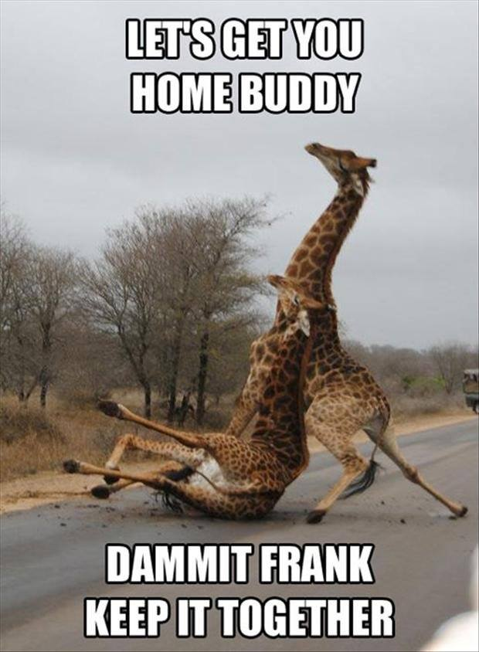
Timeline
Planning oral exams
Grammar: Past Simple and Present perfect
Work from the book
Notes:
Afbeelding: https://www.flickr.com/photos/studiodxavier/6063335422

Slide 2
Planning oral exams
Week | DV21 A – 1 | DV 21 A – 2 | DV 21 C | HO 21
3 | Demi, Indy | Ties
4 | Steffie, Gijs | Dennis
5 (8/9 Dec.) | Test: Vocab + Grammar Gijs | Test: Vocab + Grammar | Chelsey Angela Floortje
6 (15/16 Dec) | Steffie Demi Indy Lynn | Lisa |  | Ilja Yoeri Sofie Lars
7 (5/6 Jan) | Naomi Lana | Jaimy | Roksana Romy Noa
8 (12/13 Jan) |  | Pim, Alicia |  | Niels Martijn Sander Thijs
9 (19/20 Jan) |  |  | Oliwia Anouk Rosa

Slide 3
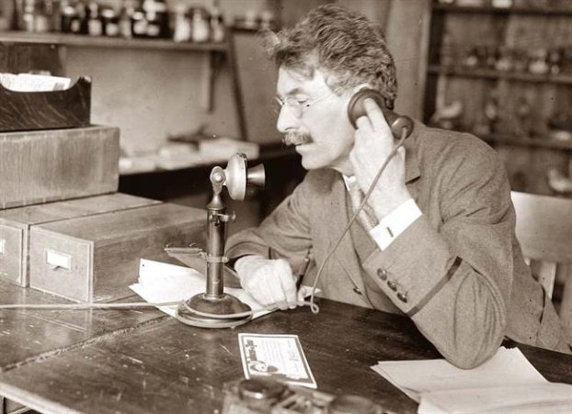
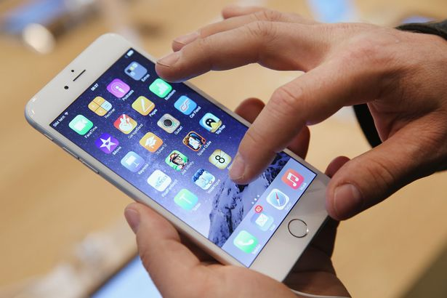
Past Tense
Past Present Future

Slide 4
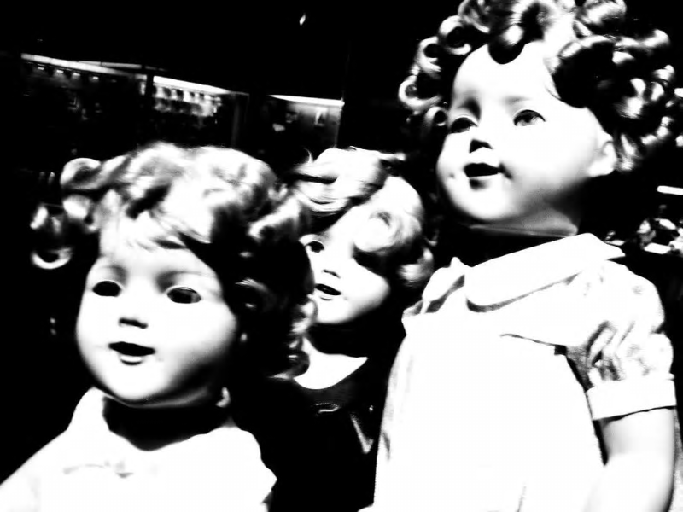
Past Simple
Assignment A
Listen to the story and underline the verbs in the past tense on your worksheet.
Make this assignment on your
own.
We will check the assignment
together.
Notes:
Verhaal komt van: https://www.buzzfeed.com/awesomer/boo-scared-you

Slide 5
Past Simple – Regular verbs
When
Duidelijk wanneer
Indicator
Yesterday
In 1983
Last week
Three days ago
A minute ago
When I was young
Rule
WW + ed
How
I worked
You worked
She/ He/ It worked
We worked
They worked

Slide 6
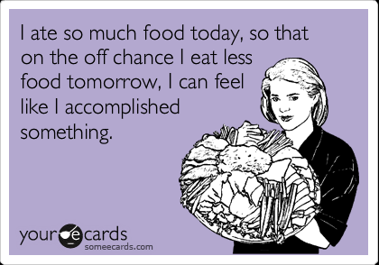
Past Simple – Irregular verbs
Irregular verbs
We also have them in the Dutch language
Regular rule doesn’t apply
Have to learn by heart
There are about 150 – only have to learn 30 (hand out)

Slide 7
Past Simple – Regular and Irregular verbs
Assignment B:
Look at the list of irregular verbs
Read the story again and circle the irregular verbs in the past tense.
Notes:
De foto is de link naar de clip. Deze tekst staat in het begin van het nummer.

Slide 8
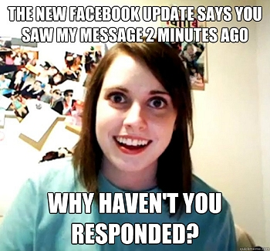
Present Perfect – Example
Past Simple
Present Perfect

Slide 9
Present Perfect – Example
Past Simple
Present Perfect

Slide 10
Present Perfect – Example
Past Simple
Present Perfect

Slide 11
 | Past Simple Ik werkte | Present Perfect Ik heb gewerkt
When | Duidelijk wanneer het gebeurd is | Onduidelijk wanneer het gebeurd is
Rule | ww + ed | Have/ has + ww + ed
Uitzonderingen op de regel | Irregular verbs (onregelmatige ww.) zijn allemaal verschillend en moet je uit je hoofd leren. Krijg je op stencil.
How I | worked | have worked
You | worked | have worked
She / He / It | worked | has worked
We | worked | have worked
They | worked | have worked
Indicator | - Yesterday | - For
 | - In 1983 | - Yet
 | - Last week | - Never
 | - Three days ago | - Ever
 | - A minute ago | - Just
 | - When I was young | - Already
 |  | - Since
 |  | - Once
 |  | - Recently

